Slide 1
Implementation And Evaluation

Slide 2
Learning Objectives
At the conclusion of this training participants will be able to:
Name the three components necessary for effective implementation.
Identify ways to build capacity for implementation and evaluation.
.

Slide 3
Learning Objectives Cont.
Identify ways to use an action plan to increase successful implementation, evaluation and sustainability.
Identify ways to ensure programs and practices are implemented with fidelity.
Describe the two types of evaluation and identify why each is important.
.

Slide 4
Welcome
and Introductions
Source: Bing Images

Slide 5
Opening Activity

Slide 6
Victory Circles
What will success look like?
What will you hear?
What will you see?
Source: Bing Images

Slide 7
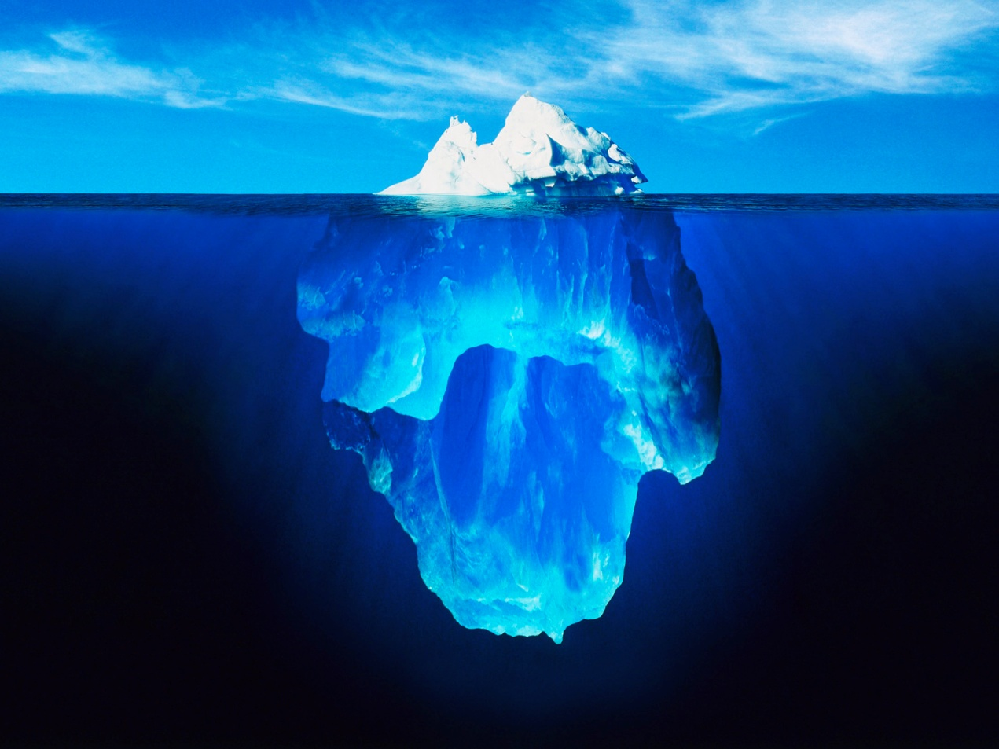
Identifying Underlying Contradictions
Source: Bing Images

Slide 8
Lunch Break
Source: Bing Images

Slide 9
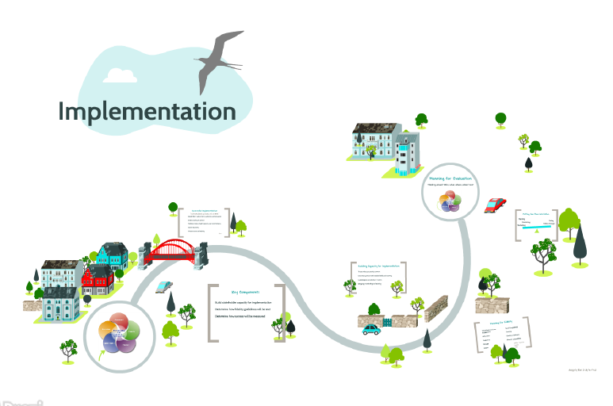
Implementation Overview

Slide 10
Carousel Walk Activity
Source: Bing Images
Notes:
Carousel Walk Activity-10 minutes
Sectors will be listed on Post-It Paper throughout the room.
Each County will be asked to work together and write “Ideas/wins/unique experiences they have had with each sector.”
We know there have been successes and challenges with capacity in the past. Today we want to focus on the success of others and learn from approaches others have taken.
Bring back together. Aim of the activity was to share what other counties have tried in engaging different sectors; giving ideas to other counties. Look at how you can engage stakeholders in ways that you may not have thought about in the past. You may work with your coalition, council and /or capacity coach on targeted ideas you have in approaching different sectors.

Slide 11
Focused Conversations
Source: Bing Images

Slide 12
Closing

Slide 13
Welcome Back!

Slide 14
Opening Activity

Slide 15
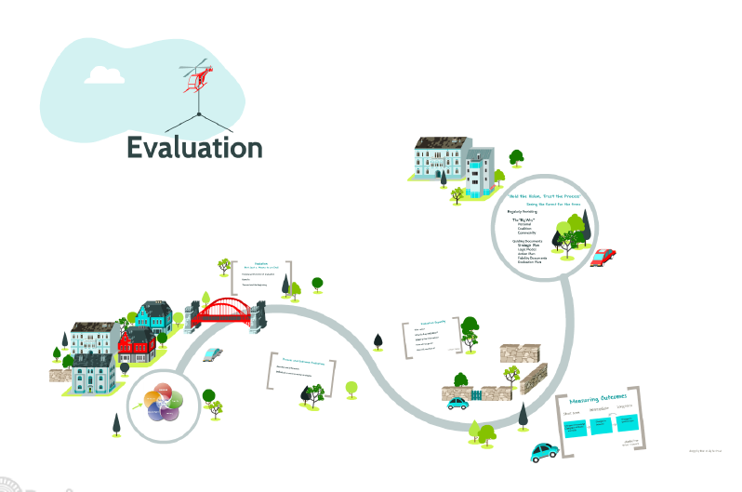
Evaluation Overview

Slide 16
Lunch Break
Source: Bing Images

Slide 17
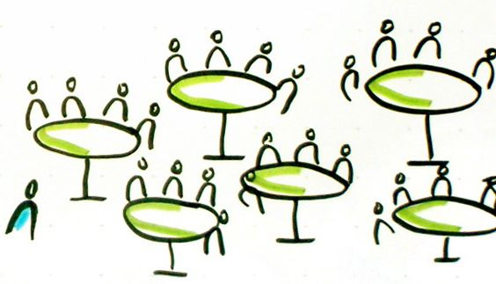
World Cafe
Source: Bing Images

Slide 18
Parking Lot and IDPH Updates
Source: Bing Images

Slide 19
Closing

